Slide 1
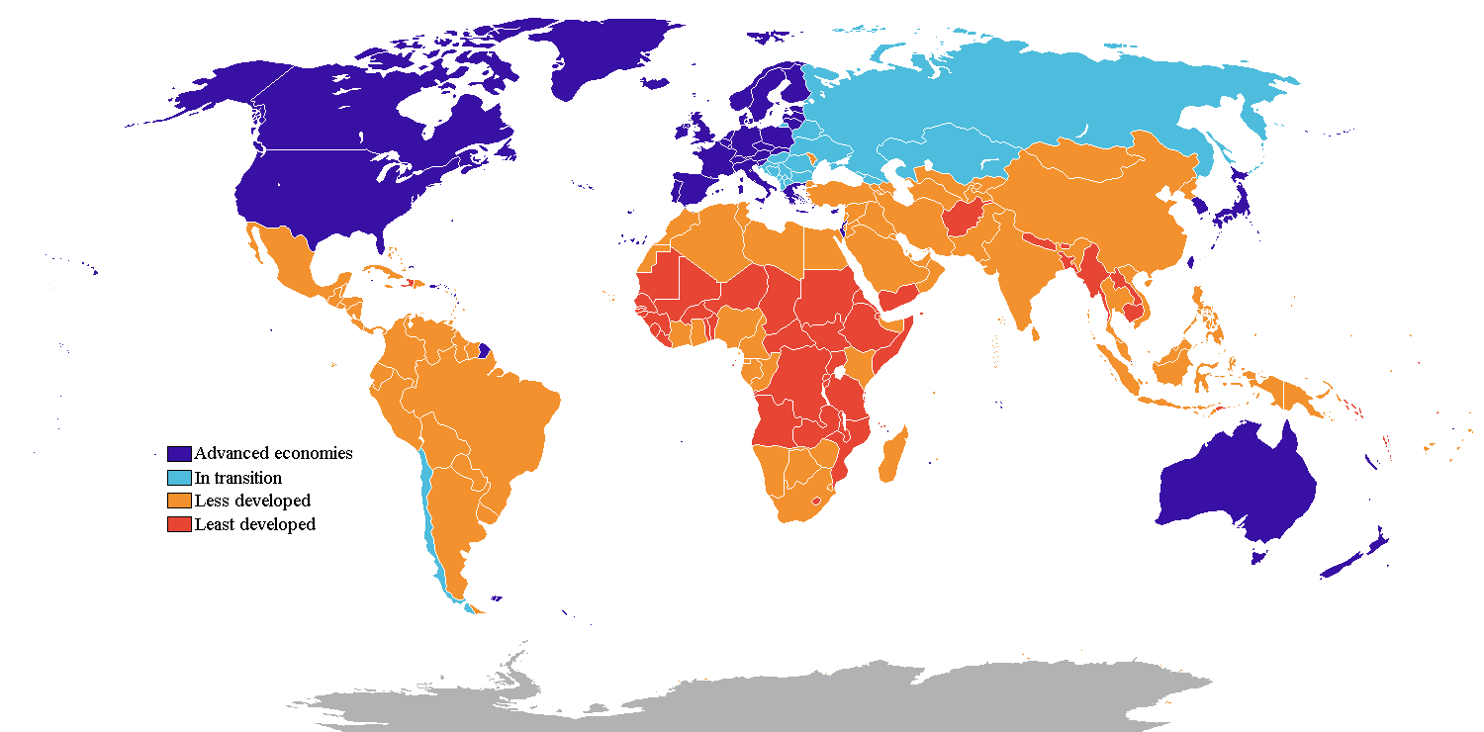
The Predictive Power of Food Consumption
Taylor Sullivan

Slide 2
Problem Statement
“The rapid rise in [non-communicable diseases] NCDs is predicted to impede poverty reduction initiatives in low-income countries, particularly by increasing household costs associated with health care” (World Health Organization, 2018).

Slide 3
Hypothesis
H0: Food consumption has no impact on health outcomes in developing nations
H1: in nations with lower consumption of high-fat and high-caloric foods, there are more favorable health outcomes
H2: nations with greater consumption of high-fat and high-caloric foods result in better health outcomes

Slide 4
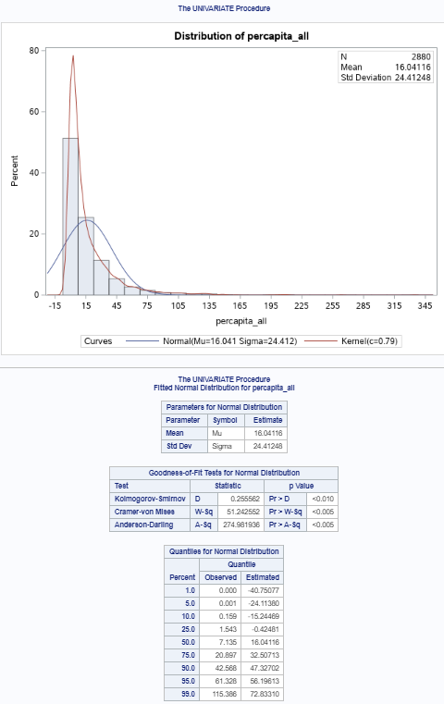
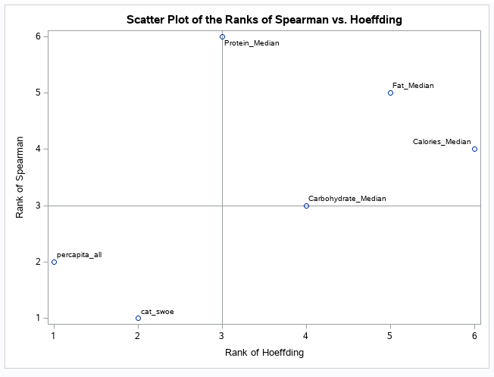
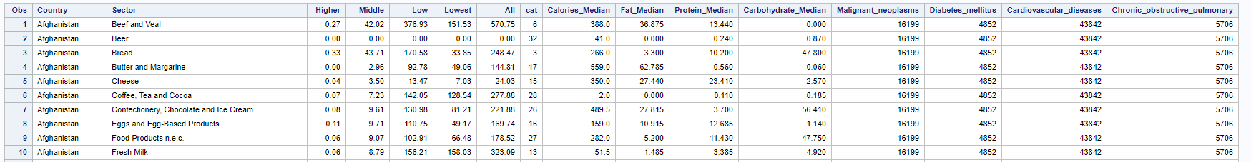
Data Analysis Process
Normalcy
(Yap, 2011)
Linear Association
Gathering the Data
(World Bank Group, 2010) (U.S. Department of Agriculture, 2020) (Data Hub, 2018) (World Health Organization, 2018)
(SAS Institute, 2018)
Notes:
The data first needed to be analyzed to see if it met the assumptions for modeling: normalcy, linear association, homogeneity, residual normalcy, and various statistical thresholds for these metrics. The data met the basic assumptions necessary for modeling.

Slide 5
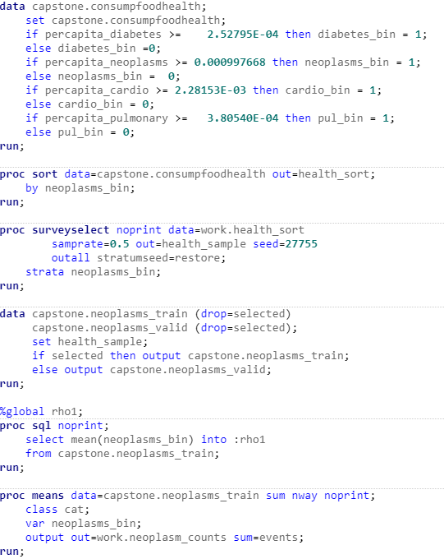
Data Analysis Process
The upper quartile of health outcome rates is used to create a binary target variable
The data is divided into training and validation datasets with equal number of target events
Smoothed weight of evidence is used to modify the food category variable (SAS Predictive Modeling, 2020).
(SAS Institute, 2018)

Slide 6
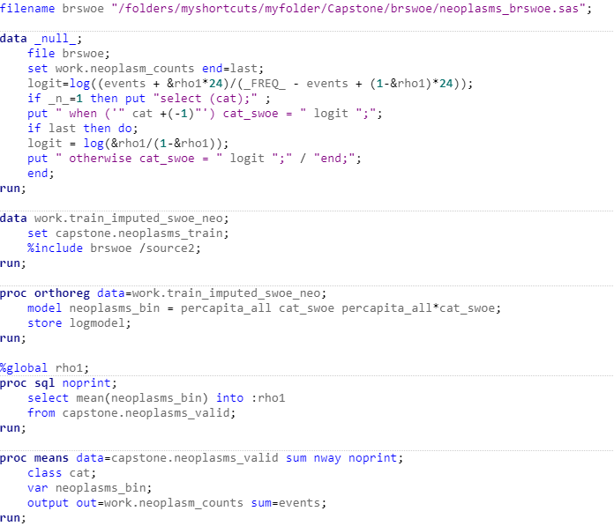
Data Analysis Process
This code builds the model off of the training dataset
The validation dataset is prepared with the smooth weight of evidence technique
(SAS Institute, 2018)

Slide 7
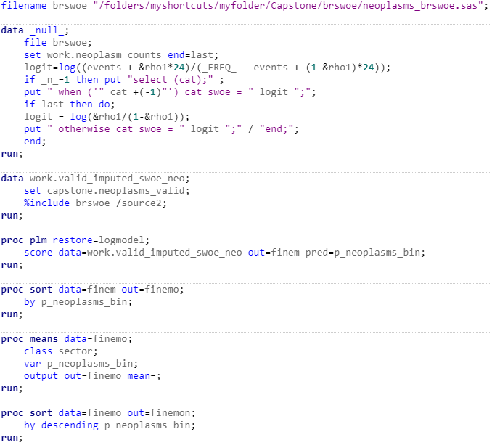
Data Analysis Process
The predictive model was scored, the scores were then evaluated by each food category
(SAS Institute, 2018)

Slide 8
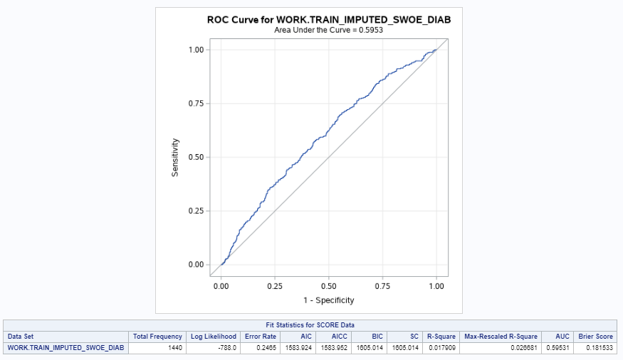
Data Analysis Process
(Narkhede, 2018)

Slide 9
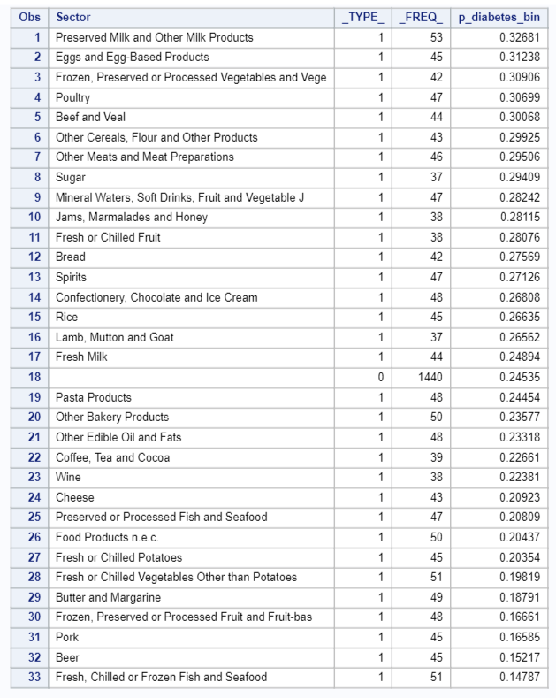
Outline of the Findings: Diabetes Mellitus
(SAS Institute, 2018)
Notes:
The highest predictor for diabetes was preserved milk and milk products, eggs and egg-based products, and preserved vegetables. On the other hand, foods least associated with diabetes were seafood, beer, and pork.

Slide 10
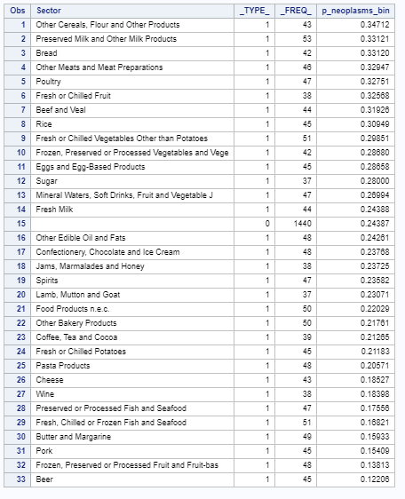
Outline of the Findings: Malignant Neoplasms
(SAS Institute, 2018)
Notes:
The highest predictors for malignant neoplasms were flour and cereal, preserved milk and milk products, bread, and other meats. The lowest predictors for malignant neoplasms were beer, frozen fruit, and pork.

Slide 11
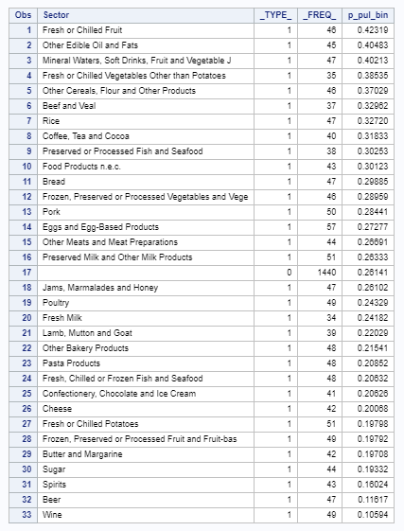
Outline of the Findings: Chronic Obstructive Pulmonary
(SAS Institute, 2018)
Notes:
The highest predictors for chronic obstructive pulmonary disease were fresh fruit, oil and fats, and soft drinks and juice. The lowest predictors for chronic obstructive pulmonary were wine, beer, and spirits. A glass of alcohol per day has been linked to greater health overall, however lower consumption can also be due to religious reasons.

Slide 12
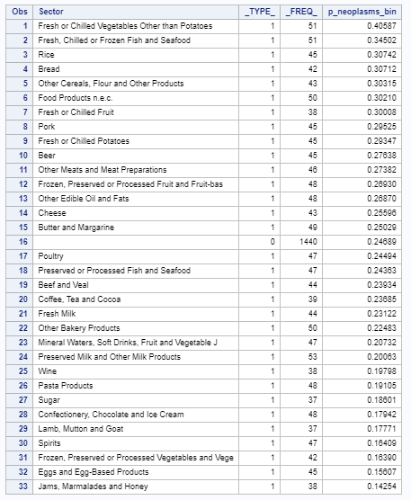
Outline of the Findings: Cardiovascular Disease
(SAS Institute, 2018)
Notes:
The highest predictors for cardiovascular disease were fresh vegetables, fresh seafood, and rice. The lowest predictors for cardiovascular disease were jams, eggs and egg-based products, and frozen vegetables. One consideration is that many of the developing countries have a state religion that forbids the consumption of alcohol and pork. Additionally, seafood is not as available in regions farther inland, possibly explaining its presence at the bottom of the list.
Overall, these findings assert that fish, fruit, vegetables, cheese, and pasta were overwhelmingly negatively associated with NCDs. Alternatively, rice, bread, cereals and flour, as well as oils and fats have a strong positive relationship with NCDs overall. While some of these foods are more commonly consumed with each meal, another reason could be that their nutritional value is the culprit.

Slide 13
Limitations
Smooth Weight of Evidence
Normalcy
Binary Target Variable
Cumulative Limitations of Various Datasets
Notes:
The data is limited by the confusion caused by using a smoothed weight of evidence to represent the food category variable. As a result of this fact, the data is difficult to interpret. However, if interpreted with this in mind, the model results can serve as an indicator for emerging nations to shift the focus of their markets to certain food groups that are not correlated with higher rates of NCDs.
Upon examination the original dataset did not depict a high degree of normalcy. However, instead of reducing the diversity and variance of the dataset, the study proceeded with the abnormal data. This could affect the results of the study and another model that adjusts for normalcy should also be considered before drawing conclusions as a way of mitigating this limitation.
Another limitation is the binning of the health outcome variables so that a one would represent the top quartile of the health outcome rates, and the remainder of the rates would be zero. This was selected in order for the study to target possible causes for these extremely high rates. While this method did assist in targeting the upper rates of each health outcome, but a non-binary logit should be examined as well in order to compare the model results and validate the method. The sample dataset could be unrepresentative of the population as a whole and could affect this technique exponentially.
A main limitation of this analysis is the cumulative effect of limitations within each dataset. The food consumption rates are based on the consumption as best estimated by The World Bank. Accurate consumption rates were not available due to government entities failing to disclose, as well as the unavailability of rates due to informal markets. This combined with the fact that the median nutrition rates for each food category may not be the most accurate representation of the food category is a major constraint.

Slide 14
Expected Benefits
Identification of possibly harmful foods
Marketing strategies for healthy options
Identification of high-risk areas based on food consumptions
Allocation of health resources
Preventative measures vs. diseases
Notes:
There must be many more studies conducted in order to confirm the results of this study and take action with them. However, a significant relationship has been identified, and the particular food groups that are positively or negatively related to the target non-communicable disease should be examined for their potential harmful/beneficial effects on the population at large. Once this study is validated with further research and analysis, this study will be able to advise companies on marketing strategies for foods that are negatively correlated with NCDs. It could also be used to inform governments of which areas of the country are at highest risk for each NCD, based on the food consumption rates in that area. Governments can, in turn, use that information to re-allocate health resources in these at-risk areas and take preventative measures against the diseases.

Slide 15
Proposed Actions
Collection of more cohesive data
Repeated iterations of the study
Use of different modeling and analysis techniques for comparison
In-depth analysis of particular regions within countries
Notes:
In summary, there is clearly a significant relationship between food consumption rates, the categories of food being consumed, and the subsequent health outcomes. This relationship should be further analyzed with more accurate data that analyzes more specific food groups and more legitimate nutrition information. This would provide a better model that would assist the resourcing of developing nations. A more in-depth analysis of the specific areas within these countries that are consuming each food would be more useful for these purposes as well.

Slide 16
Sources
Data Hub. (2018). In Population Figures by Country. John Snow Labs. Retrieved July 10, 2020, from https://datahub.io/JohnSnowLabs/population-figures-by-country#readme.
Narkhede, S. (2018, June 26). Understanding AUC - ROC Curve. Medium. https://towardsdatascience.com/understanding-auc-roc-curve-68b2303cc9c5.
SAS Institute. (2018). SAS University EditionVersion (3.8). S.l.
SAS Institute. (2020). Predictive Modeling Using Logistic Regression (15.1). https://vle.sas.com/course/view.php?id=3472.
U.S. Department of Agriculture. (2020, April). Download FoodData Central Data. Retrieved May 08, 2020, from https://fdc.nal.usda.gov/download-datasets.html.
World Bank Group. (2010). Global Consumption Database. Retrieved May 08, 2020, from http://datatopics.worldbank.org/consumption/product/Rice.
World Health Organization. (2018, April 5). NCD Deaths by Cause and Sex - Data by Country. Retrieved May 08, 2020, from https://apps.who.int/gho/data/view.main.NCDDEATHCAUSESNUMBERv?lang=en.
Yap, B. W., &amp; Sim, C. H. (2011). Comparisons of various types of normality tests. Journal of Statistical Computation and Simulation, 81(12), 2143–2155. https://doi.org/10.1080/00949655.2010.520163.

